Slide 1
Data Science for Marketing
Module 3

Slide 2
Big Picture
With this in mind, the marketing department would inform the department to create a prototype.

Slide 3
Extracting knowledge (and actionable insights) from data using scientific methods
DATA SCIENCE

Slide 4
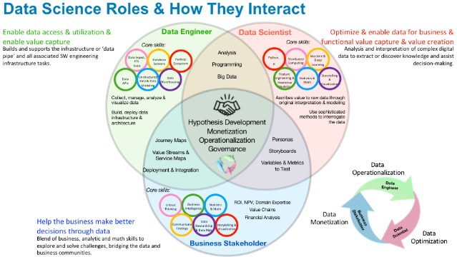
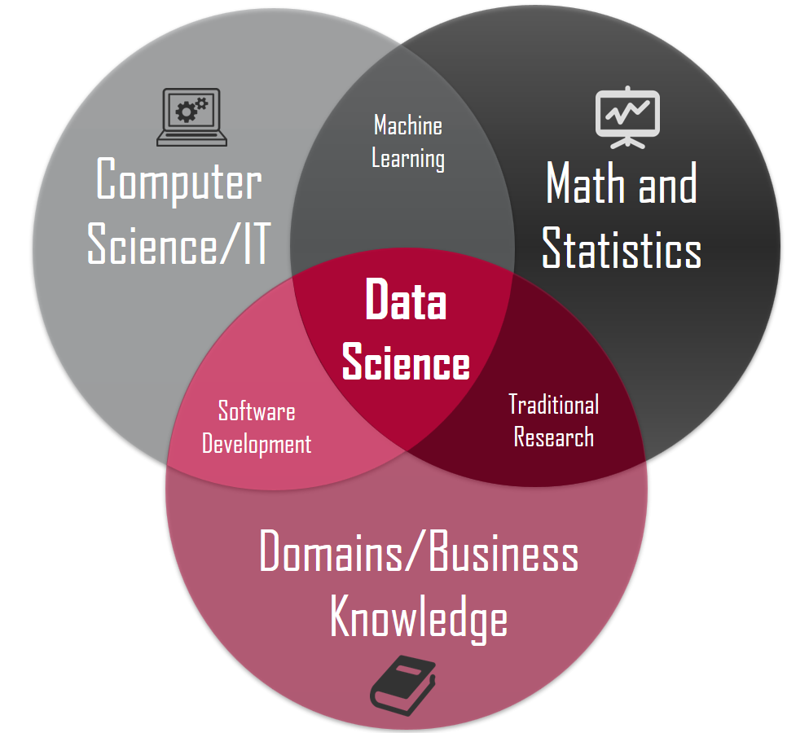
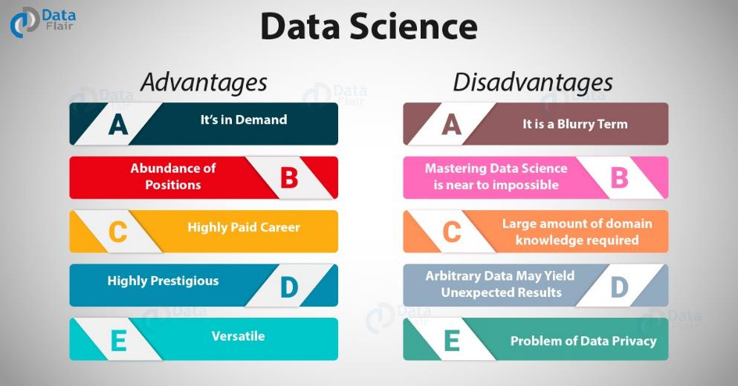
DATA SCIENCE
https://www.datasciencecentral.com/profiles/blogs/new-books-and-resources-for-dsc-members
+ Marketing!
https://towardsdatascience.com/introduction-to-statistics-e9d72d818745
https://towardsdatascience.com/why-choose-data-science-for-your-career-ca38db0c28d4

Slide 5
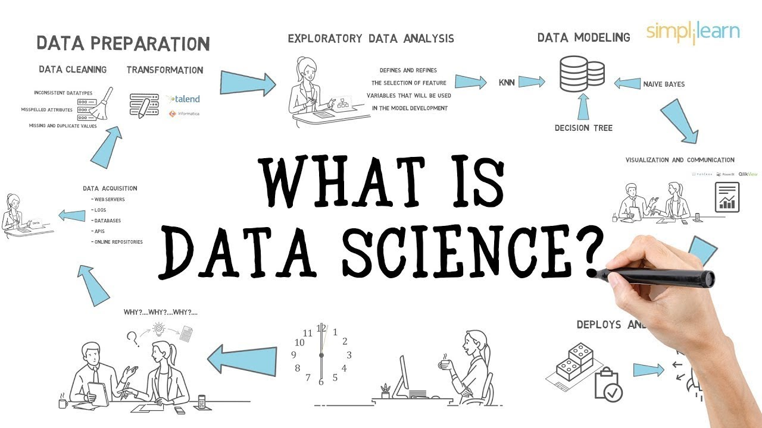
DATA SCIENTIST: DAY TO DAY ACTIVITIES
IMPORTANT TO KNOW:
High demand
Usually requires an advanced degree
Good salary
Solitary work
Limited interaction with others
Uses intermediaries
https://www.youtube.com/watch?v=X3paOmcrTjQ

Slide 6
SIDEBAR: MOST IMPORTANT QUALITIES
A CRITICAL EYE
CURIOSITY
Does this make sense?
How can I verify this?
How does this compare to what I already know?
Is the source credible?
How was this calculated?
WHY?
What could be happening to cause this?
What drives action?
Keep going until you find an answer!
Willing to ask others/brainstorm.
You’ll figure things out that others won’t.
OTHER STUFF
Understand mathematical concepts; know what formulas to apply and when.
Ability to summarize key points; translate complex things for non-technical audience.
Data visualization best practices.
Attention to detail. (Analysis is all about the details! Also helps detect errors, review your work.)
Able to be objective, tactful, and honest (even if it’s bad news).
Technical skills: everything you’ve learned in your DA program so far.

Slide 7

Data Mining
Data Science is the WHAT
Data Mining is the HOW
With this in mind, the marketing department would inform the department to create a prototype.

Slide 8
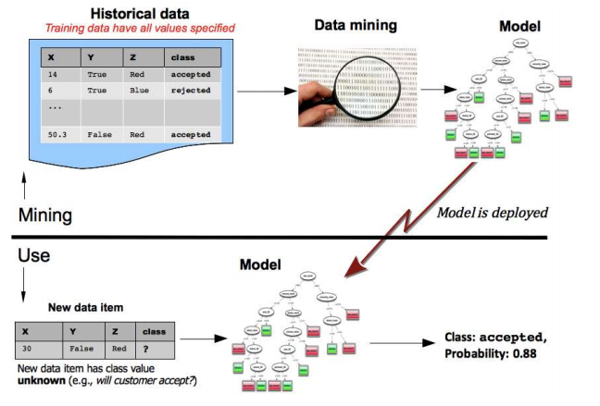
DATA MINING PROCESS
Data mining is conducted on historical data
to produce a model.
Model is then applied to new data to answer the original business question.
Figure 2-1, Data Science for Business

Slide 9
COMMON DATA MINING TASKS
CLASSIFICATION
REGRESSION
Classification attempts to predict, for each
individual in a population, which of a set of
classes that individual belongs to.
Classification algorithms provide models that determine which class a new individual belongs to
Classifications are mutually exclusive (binary)
Business/Marketing Use:
“Among all the customers of a cellular company,
which are likely to respond to a given offer?”
Regression (value estimation) attempts to estimate
or predict, for each individual, the numerical value
for that individual.
Regression models are generated by looking at other
similar individuals in the population.
Similar to classification, but looks at “how much” instead of answering yes/no question.
Business/Marketing Use:
“How much will a given customer use the service?”
“How likely is it that a customer will do X?”

Slide 10
COMMON DATA MINING TASKS
SIMILARITY MATCHING
CLUSTERING
Similarity matching attempts to identify similar
individuals based on the data known about the
Individuals.
Find similar entities
Basis for making product recommendations
Business/Marketing Use:
Find people who are similar to you in terms of the products they have liked or purchased and recommend other products. [Amazon, Netflix]
Clustering attempts to group individuals in a
population together by their similarity, but without
regard to any specific purpose
Result in groupings of the individuals of a population
Business/Marketing Use:
“Do our customers form natural groups or segments?”
Group 1: buys shoes, cologne, > 5 purchases per year

Slide 11
COMMON DATA MINING TASKS
LINK PREDICTION
DATA REDUCTION
Attempts to predict connections between data items.
Look for areas where a link does not exist and suggest that a link should exist
Business/Marketing Use:
Social media friend recommendations (Facebook, LinkedIn)
Amazon, Netflix recommendations
Attempts to take a large dataset and replace it with a smaller set of data that contains the relevant/important information of the larger set.
Trade-off of less information but improved insight
Business/Marketing Use:
Taking a customer file with multiple geographic variables including latitude and longitude and summarizing it to customers by state.

Slide 12
COMMON DATA MINING TASKS
CAUSAL MODELING
Attempts to understand what events or actions influence others.
Randomized controlled experiments (A/B tests)
If a control group is used, they will not be targeted (sacrifice for the greater good of gaining insight)
Business/Marketing Use:
Does a specific offer entice people to make a purchase?
Email subject lines (which has higher open rate)

Slide 13
SUPERVISED vs. UNSUPERVISED METHODS
SUPERVISED
UNSUPERVISED
Specific target is defined
Must have data on the target in order to model with it
“Will our customers buy the product if given an incentive?”
“What is the likelihood this customer will churn?”
No specific purpose or target is defined
Exploratory
“Do our customers naturally fall into different groups?”
“What products are bought together?”

Slide 14
CHAPTER 13: pages 326-328
Data Mining Proposal and Evaluation

Slide 15
Thank You

